Slide 1
BOM

Slide 2
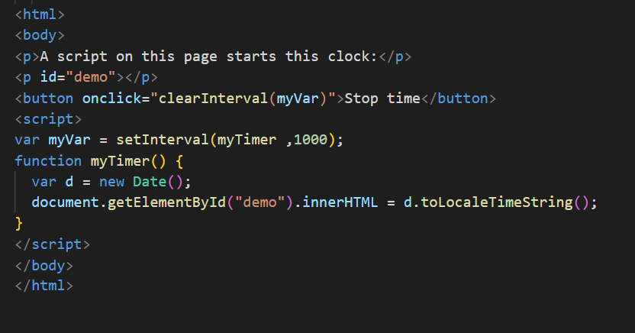
setInterval

Slide 3
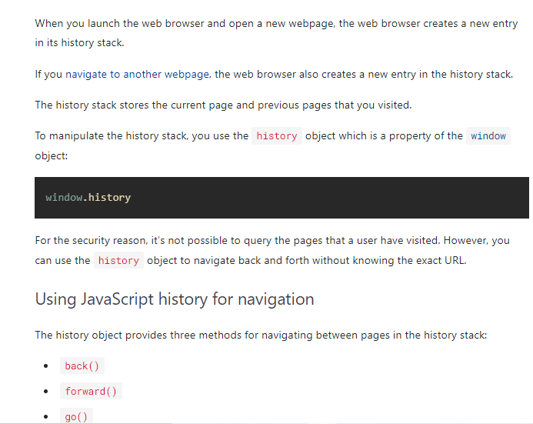
2. Window.history

Slide 4
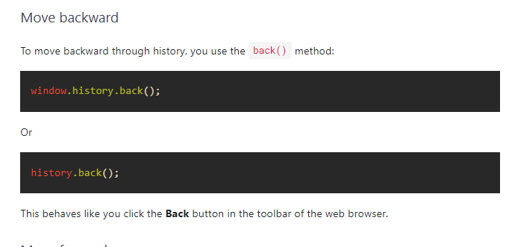
Move Backward

Slide 5
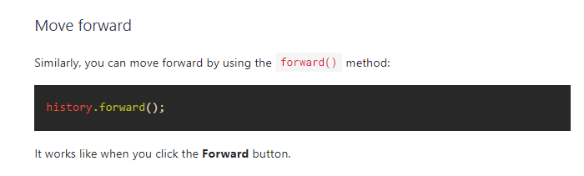
Move Forward

Slide 6
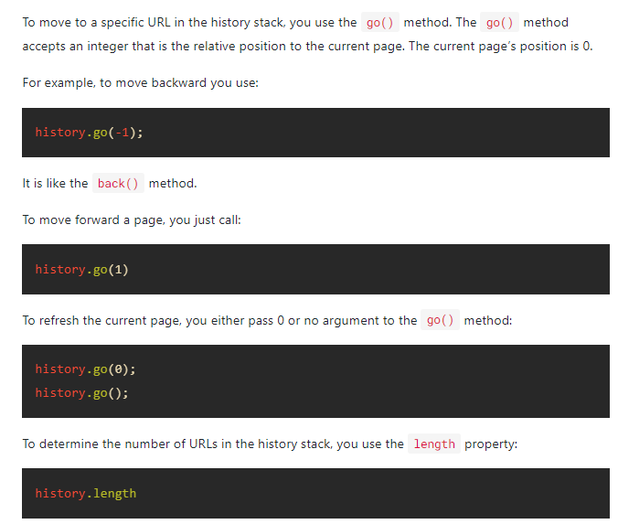
URL History

Slide 7
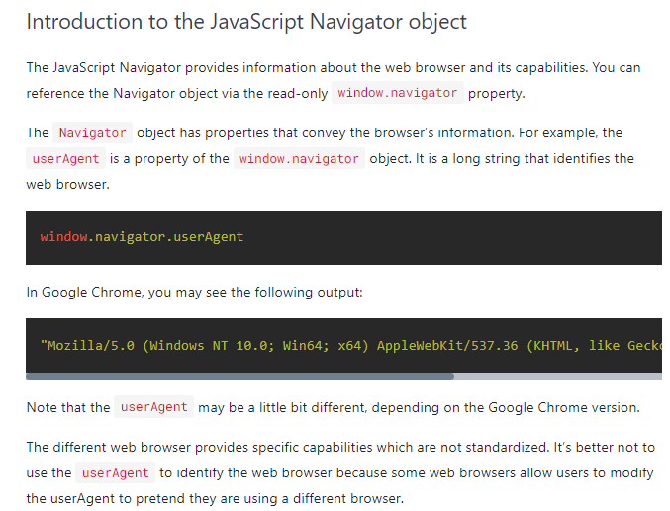
3. Window.navigator

Slide 8
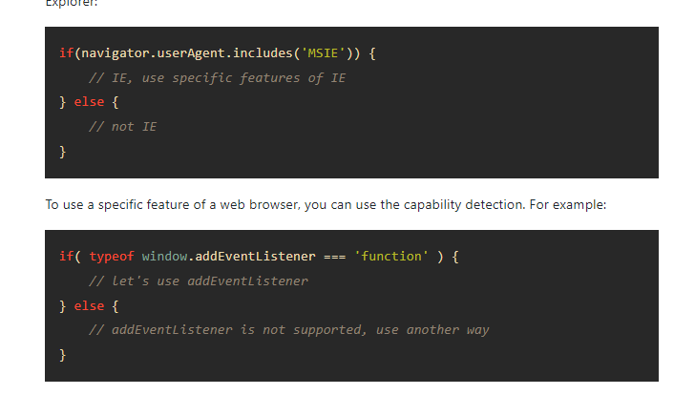

Slide 9
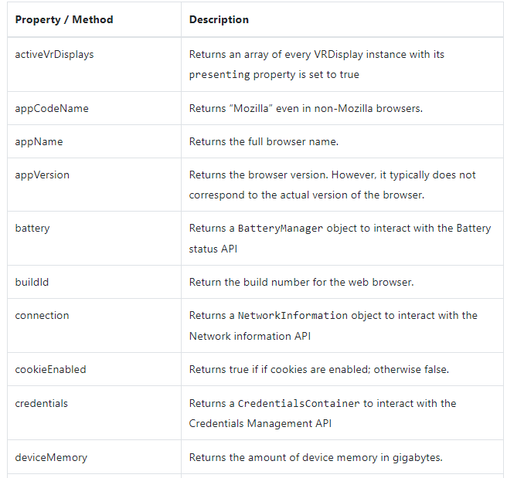
JavaScript Navigator Properties & Methods

Slide 10
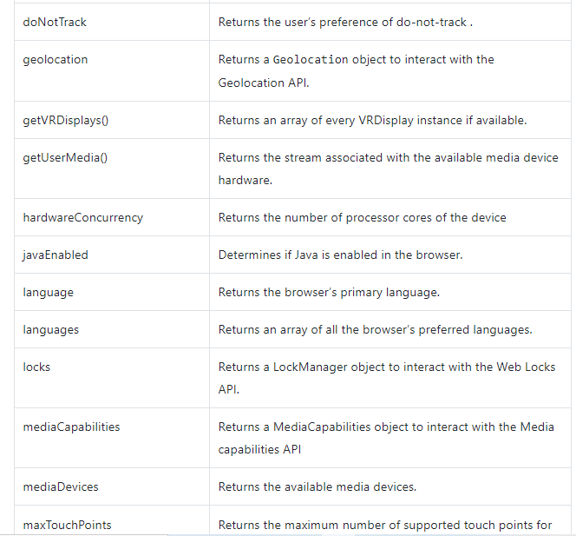
JavaScript Navigator Properties & Methods

Slide 11
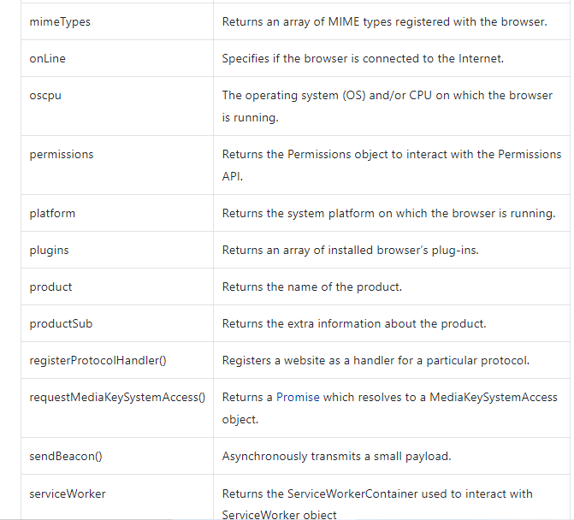
JavaScript Navigator Properties & Methods

Slide 12
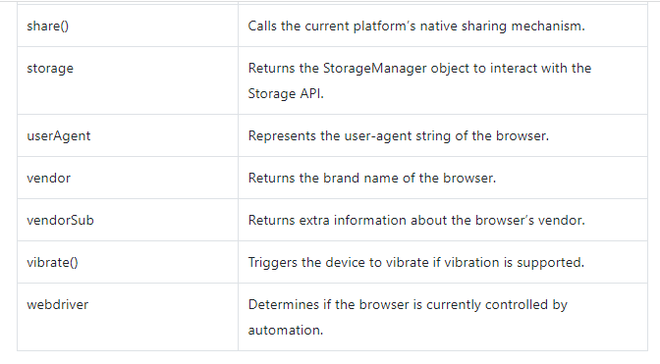
JavaScript Navigator Properties & Methods

